Slide 1
Topic 3.3 Turning Commands into a Script
How to Prepare for the LPI Linux Essentials Certification Exam
C851 Cohort Session for Sunday, August 22, 2021
Dr. John S. Galliano | C851 Linux Foundations Instructor

Slide 2
Agenda
Welcome
About the Exam
The 5 Exam Domains
Topics/Weightings
LPI Retake Policy
Demos/Hands-on
Sample Exam Questions
Wrap-Up

Slide 3

About the Linux Essentials v1.6 [1]
No prerequisites
Closed book, up to 60 minutes
40 multiple-choice (with some multi-select and fill-in-the-blank items) questions
Minimum pass score 500 points (200-800 scale)
Partially correct responses not accepted (for F-I-T-B questions LPI may accept multiple correct versions of an answer [2]
Total exam weight count is 40, thus 40 questions
[1] Linux Professional Institute, “Linux Professional Institute Linux Essentials,” Linux Professional Institute, 21-Oct-2018. [Online]. Available: https://www.lpi.org/our-certifications/linux-essentials-overview. [Accessed: 14-Aug-2021]
[2] Dr. Galliano’s correspondence with LPI, dated August 2021: Example: with/without leading path in a case where the answer is a command
Notes:
Example: If an objective has a weight of 4, there will be 4 questions on the exam related to that objective [2]
Link: 3rd party cert tips video https://bit.ly/3party_cert_tips

Slide 4

5 Exam Domains [3]
The Linux Community and a Career in Open Source
Finding Your Way on a Linux System
The Power of the Command Line
The Linux Operating System
Security and File Permissions
[3] Linux Professional Institute, “Linux Essentials Objectives V1.6 - LPI Wiki,” Linux Professional Institute, 25-Jan-2020. [Online]. Available: https://wiki.lpi.org/wiki/Linux_Essentials_Objectives_V1.6. [Accessed: 14-Aug-2021].

Slide 5

Exam Topics/Weightings
Linux Essentials v1.6 Exam Topics [4] | 1.1 | 2
 | 1.2 | 2
 | 1.3 | 1
 | 1.4 | 2
 | 2.1 | 3
 | 2.2 | 2
 | 2.3 | 2
 | 2.4 | 2
 | 3.1 | 2
 | 3.2 | 3
 | 3.3 | 4
 | 4.1 | 1
 | 4.2 | 2
 | 4.3 | 3
 | 4.4 | 2
 | 5.1 | 2
 | 5.2 | 2
 | 5.3 | 2
 | 5.4 | 1
 |  | 40
[4] Linux Professional Institute, “Linux Essentials Objectives V1.6 - LPI Wiki,” Linux Professional Institute, 25-Jan-2020. [Online]. Available: https://wiki.lpi.org/wiki/Linux_Essentials_Objectives_V1.6. [Accessed: 14-Aug-2021].
Notes:
• A weight of “1” equates to 1 exam question
• Since there is a weight of ‘4’, you will see 4 questions on scripting!

Slide 6

LPI Exam Re-Take Policy [5]
Anyone who takes an LPI exam once must wait one week before re-taking
Anyone who takes an LPI exam a second (and subsequent) time must wait 30 days before re-taking
These are LPI policies, not WGU policies!
[5] Linux Professional Institute, “Privacy Statement and Policies,” Linux Professional Institute, 18-May-2018. [Online]. Available: https://www.lpi.org/policies. [Accessed: 14-Aug-2021].
Notes:
• Anyone who passes an LPI exam may not retake that exam for two years

Slide 7

3.3 Turning Commands into a Script [6]
Weight: 4 (4 questions)
Key Knowledge Areas:
Basic shell scripting
Common text editors (vi and nano)
Files used, terms and utilities:
#! (shebang)
/bin/bash
Variables
Arguments
for loops
echo
Exit status
[6] Linux Professional Institute (LPI), “Exam 010 Objectives,” Linux Professional Institute, 21-Oct-2018. [Online]. Available: https://www.lpi.org/our-certifications/exam-010-objectives. [Accessed: 10-Jul-2021].
Notes:
• commands used in today’s content, ‘#’ denotes a comment
echo “Hello World” #prints the info in double quotes to STDOUT
echo $SHELL #prints the value of current shell to STDOUT
echo $@ #prints the value of any parameters passed to the script
echo $? #was the last command exit successful? (0 means 'yes', 1 means 'no’)
ipaddress=“192.168.1.5” #assigns a specific ip address to the variable ipaddress
echo $ipaddress #prints the value of the variable to STDOUT
export, export –p #used to make the variable available to the shell
export EDITOR=/usr/bin/vim #changes the default editor to vim!
export |grep EDITOR #finds the value of the EDITOR env variable; prints to STDOUT
touch <name of script> #creates an empty file
vim <name of script> #edits the script
ls –ltr #checks if the script was updated
cat <name of script> #prints the contents of the script to STDOUT
chmod a+x <name of script> #makes the script executable for all users
• Link: https://explainshell.com/
• Link: https://www.cheatsheet.wtf/bash/

Slide 8
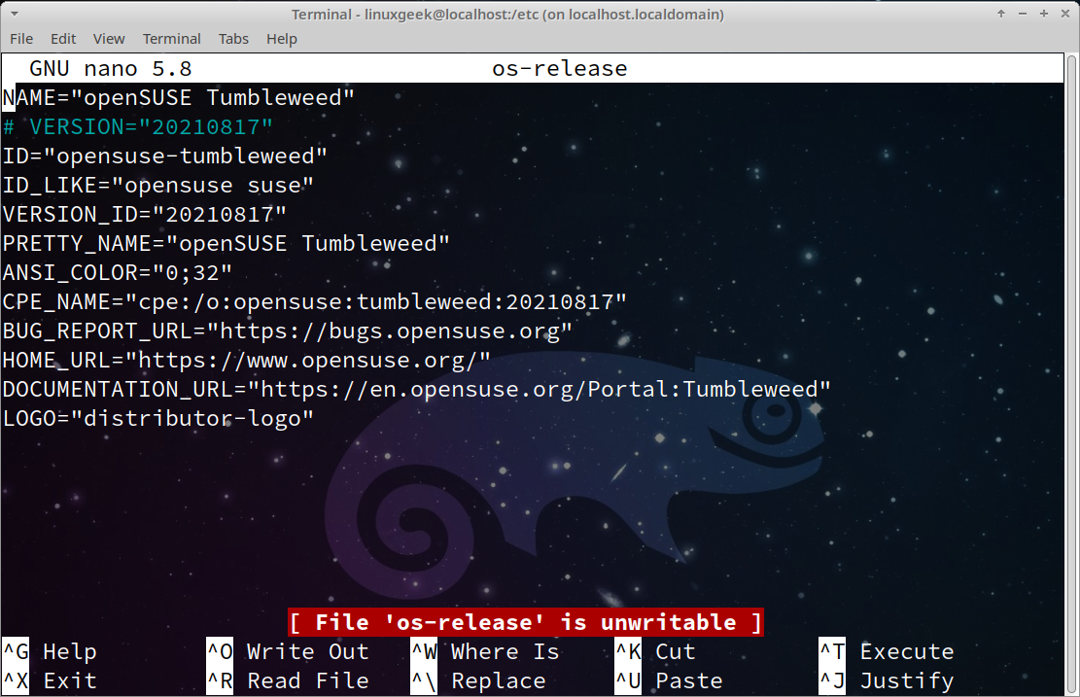
Common text editors (vi, nano)
nano
vi/vim
Demos
Notes:
• Graphic: nano editor with contents of /etc/os-release file
• Link: Cheatography Nano Cheat Sheet
• Link: PhoenixNap Vim Cheat Sheet

Slide 9

Basic shell scripting
What is a script?
Brainstorm activity
Notes:
• Share Opensource.com: Bash Cheat Sheet
- has good export examples, how to examine executables, redirection, and

Slide 10
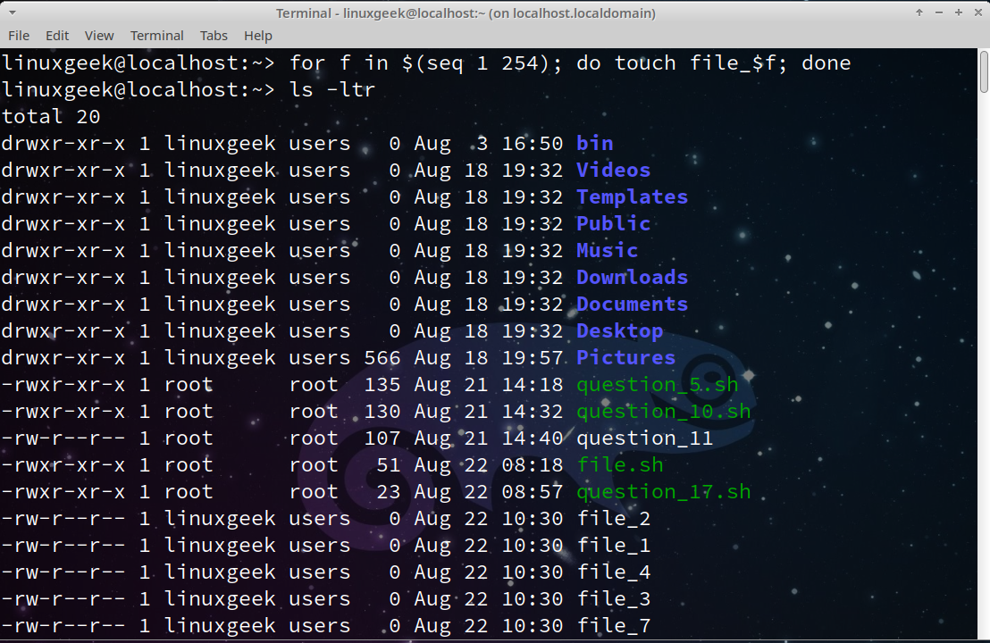
Basic Scripting Elements
#! (shebang)
/bin/bash
echo
exit status
variables
arguments
for loops
Notes:
• Variables
- The name of a variable should only contain letters (a to z or A to Z), numbers ( 0 to 9), or the underscore character ( _). Variables should also always start with a letter
- The command export is used to make a shell variable known to subsequently executed programs. Essentially, the export command creates a globally accessible variable when it is run.
• Arguments
$0 = name of the script
$1, $2, $3, = positional arguments
$# = number of arguments
$@ = what parameters were passed
$? = was last command successful, 0 means 'yes', 1 means 'no’
• for loops are the power of iteration
Example: for f in $(ls); do file $f; done (a.k.a. a bash one-liner)
• share link: https://www.zero2devops.com/blog/bash-scripting-cheat-sheet
• share file template.sh

Slide 11
What Questions Do you Have for Me?

